Slide 1

Review 2 Presentation
On
IOT BASED AUTOMATED LIGHT SYSTEM
Under the Course ”Mini Project”
By
Omkar Pandharinath Dhage (20141204)
Prathamesh Maruti Sabale (20141216)
Under the Guidance of
Prof.N.M.Mule
Government College Of Engineering , Karad
(An Autonomous Institute Of GOVT Maharashtra)

Slide 2
Introduction:
Automation in various daily used devices is becoming more and more popular and crucial these days. Automated lightening is a crucial part as it makes human life easy along with saving the wastage of electricity. Most lightening system available are expensive and complex also hard to install. Here is automated light system prototype is developed to replace the ordinary light switches. An easy to install, and automated system for saving the electricity was the ultimate goal of this project.

Slide 3
MOTIVATION
An automatic control system will allow to control the illumination and it will decrease the energy costs.
In an economy that is accepting the need for energy reduction due to the realisation of limited fossil fuels, it is important to maintain and enhance energy efficient systems.
To get rid of traditional bulbs.
An automated system to illuminate human interference.

Slide 4
EXISTING SYSTEMS
Traditional Bulbs.
Light System using Passive Infrared Sensor(PIR).
Light System using Light Dependent Resistor Sensor(LDR).
Bluetooth controlled Light system.
Automated Light System using camera as a sensor.
Automated light System using Raspberry Pie.

Slide 5
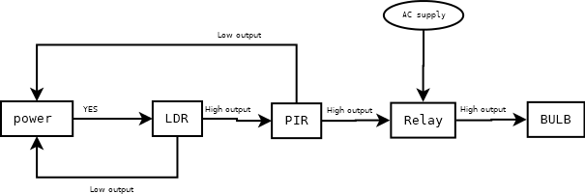
METHODOLOGY
Fig.1.1 block diagram

Slide 6
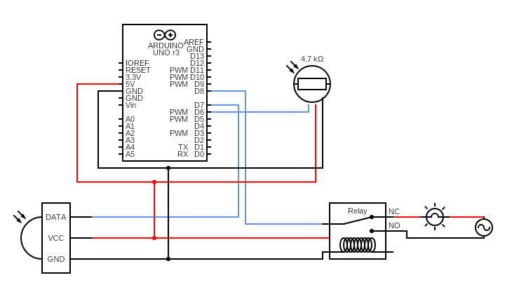
Circuit diagram
Fig.1.2 block diagram

Slide 7
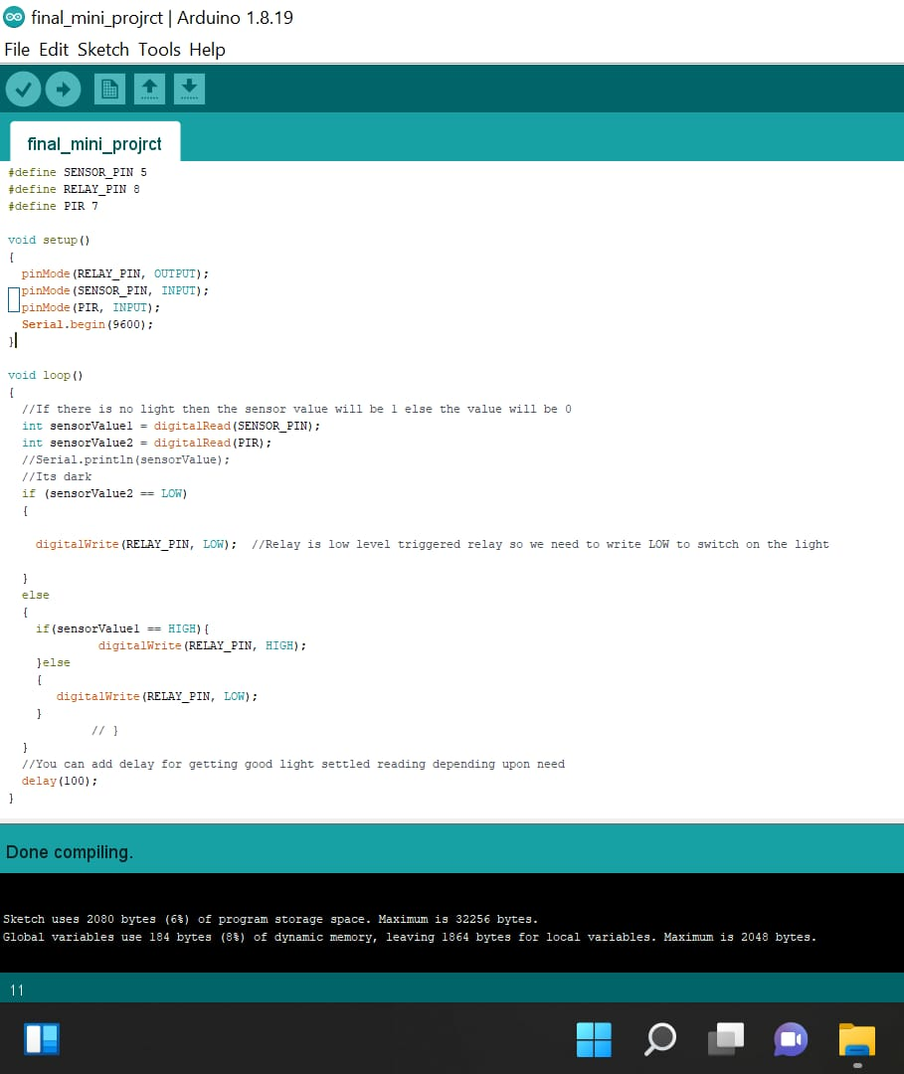
program
Fig. 1.3 program

Slide 8
RESULT

Slide 9
CONCLUSION
This elaborates the design and construction of automatic light control system circuit.
Circuit works properly to turn lamp ON/OFF. PIR and LDR sensors are the main conditions in working the circuit.
If the conditions have been satisfied the circuit will do the desired work according to specific program. Each sensor controls the turning ON or OFF the lighting column.
Here when both the conditions on two different systems are satisfied then the system works. The lights has been successfully controlled by Arduino.
Here Fully Automated System with no man power required system is built. Also the Goal of Saving Wastage Of Electricity has been achieved.
The system is Cost Effective Over Other Existing Systems and Minimum Installation Cost was required.

Slide 10
References
1..Prof.Akshay Agrawal, Mr.Mahesh Kshirsagar, Mr.Vivek Yadav, Miss.Rupali Ghodvinde ,“Motion Detection Using Arduino” International Journal for Research in Engineering Application & Management (IJREAM) 2019 Edition
2.Yogesh Pawar,Abhay Chopde, Mandar Nandre,” Motion Detection Using PIR Sensor”, International Research Journal of Engineering and Technology (IRJET) Volume: 05 Issue: 04 | Apr-2018
3.Ajay Kumar Tiwari,Prince Raj, “MOTION DETECTION USING PIR SENSOR International Journal of Scientific Development and Research (IJSDR) May 2016 Volume 1 Issue 5
4.Siti Nurmani, Bambang Tukuto, SarifaPutri Raflesia, “ Real-Time Lighting Control System for Smart Home Applications” Computer Engineering and Applications Journal · October 2018

Slide 11
References
5.Muhammad M. A. S. Mahmoud, “Automated Smart Utilization of Background Lights and Daylight for Green Building Efficient and Economic Indoor Lighting Intensity Control”, Intelligent Control and Automation Journal, 2021
6.Feng, X Guo, G Wang “Infrared motion sensing system for human-following robots G - Sensors and Actuators”, A: Physical, 2012 – Elsevier
7.Q Cao, T Yan, J Stankovic, T Abdelzaher, “Analysis of target detection performance for wireless sensor networks” - … Computing in Sensor Systems, 2005 – Springer
8.A great page on PIR sensors from GLOLAB
9.S Lee, KN Ha, KC Lee “A pyroelectric infrared sensor-based indoor location aware system for the smart home” - IEEE Transactions on Consumer …, 2006 - ieeexplore.ieee.org

Slide 12
Thank you!

